Slide 1

Pricing Your Product or Service
AREC 213

Slide 2
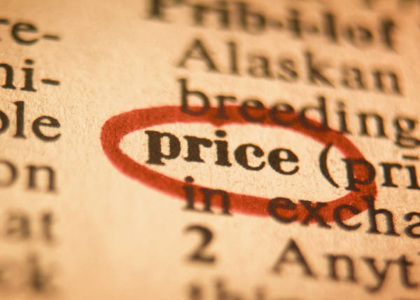
The Basics of Pricing
High or low price – you MUST provide Value to your customer.
No matter what strategy you employ to determine your price, you MUST always know your
Costs.

Slide 3
The Basics of Pricing
Most common pricing
mistakes:
1. Under pricing product or service
2. Thinking your labor is “free”
You MUST know your Costs!

Slide 4
The Basics of Pricing
You can only spend money you have built into your price.
Discounts, coupons, rebates, loyalty programs all need to be considered when setting your price.
You MUST know all your Costs!

Slide 5
Pricing Strategies
Competition-based pricing?
Successful businesses price products and services to generate a profit!
Price is not the only reason people buy . . but it sure is an important one.
Cost-based pricing?
Value-based pricing?

Slide 6

Key Pricing Terms
VALUE is what your customer believes your product is worth
PRICE is the amount of money you charge your customers per sales unit of your product
For services, this can either by hour or by job

Slide 7

Key Pricing Terms
COST is what you spend to make/buy your product or deliver your service.
On P&L this is called Cost of Goods Sold (COGS)
You MUST understand your COSTS!

Slide 8

Key Pricing Terms
Variable Costs are costs that go up or down in relation to sales volume.
Example: flour to make bread
Fixed Costs are costs that don’t change regardless of sales volume.
Example: Rent

Slide 9
So Let’s Try It!
Variable Costs are costs that go up or down in relation to sales volume.
The $4.50 is called the Gross Profit and it represents how much each unit of sales “contributes” towards paying for fixed costs, selling expenses, administrative expenses, and profits.
Example: You sell personalized T-shirts for $10.00 each
Selling Price $10.00
Variable Costs:
Raw material (t-shirt) $ 3.00
Hourly labor $ 1.00
Sales commission $ 1.00
Shipping charge $ .50
Total Variable Costs $ 5.50
Price minus Variable Costs $ 4.50

Slide 10
More Key Pricing Terms
Gross Profit is how much each unit of sales “contributes” toward paying for fixed costs, selling & administrative expenses, and NET PROFITS.
Net Profit is how much is left after EVERY expense has been paid.

Slide 11

Continuing . . . . .
Fixed Costs are costs that don’t change regardless of sales volume.
How many t-shirts do you have to sell each month to pay for your variable and fixed expenses?
Fixed Expenses per Month
Rent $ 800.00
Telephone $ 100.00
Insurance $ 50.00
Bookkeeping $ 100.00
Loan Payment $ 300.00
Total Fixed Costs $ 1,350.00

Slide 12
Let’s Look at It Again. . .
Variable Costs are costs that go up or down in relation to sales volume.
The $4.50 is called the Gross Profit and it represents how much each unit of sales “contributes” towards paying for fixed costs, selling expenses, administrative expenses, and profits.
Example: You sell personalized T-shirts for $10.00 each
Selling Price $10.00
Variable Costs:
Raw material (t-shirt) $ 3.00
Hourly labor $ 1.00
Sales commission $ 1.00
Shipping charge $ .50
Total Variable Costs $ 5.50
Price minus Variable Costs $ 4.50

Slide 13

Another Key Term. . .
Break Even is the total sales volume at which the business covers all of its expenses with nothing left over.
This can be measured in the number of units
sold or in the total dollar amount of sales.
Break Even is a critical
milestone on your
Path to Profit.

Slide 14
Your Break-Even Point
Break-Even Point (in Units) = Fixed Costs
Price – Variable Costs
(or Gross Profit)
Break-Even Point in Units = $1,350 = 300 units per month $4.50
When you sell t-shirt #301, you will start making a profit for that month. Remember – You MUST cover ALL your costs.
Break-Even (in dollars) = 300 t-shirts x $10 = $3,000
Fixed Costs $1,350.00 per month
Selling Price $10.00 per unit
Variable Costs $ 5.50 per unit
Gross Profit $ 4.50 per unit

Slide 15
Break Even – What Happens If. . .
You only charge $9.00 per t-shirt, but your
Variable and Fixed Costs stay the same?
Break-Even Point in Units = $1,350 = 386 units per month $3.50
Break-Even = 386 t-shirts x $9 = $3,474
Fixed Costs $1,350.00 per month
Selling Price $9.00 per unit
Variable Costs $5.50 per unit
Gross Profit $3.50 per unit

Slide 16

Path to Profit
At $10 per t-shirt you must sell 300 t-shirts per month to break even.
How many more must you sell to end up with $900 of Net Profit per month?
Can you sell 500 t-shirts per month and
where are these customers?
Example:
After the first 300, $4.50 per t-shirt contributes to profit
$900 ÷ $4.50 = 200 t-shirts more to make $900 per month profit.

Slide 17
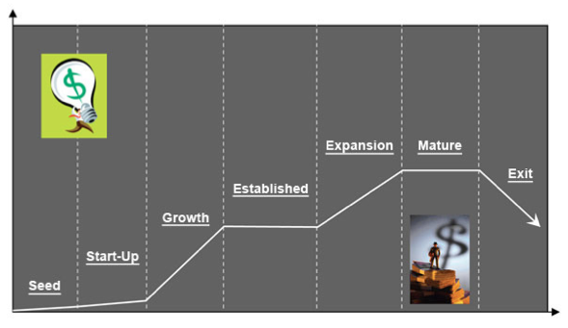
Pricing Strategies During Business Life Cycle Stages
DEVELOPMENT
GROWTH
EXPANSION
MATURITY
SATURATION
DECLINE

Slide 18
Development
Initial Market Penetration
Price/Margins
High
Price skimming
Supply/demand
Low
Market Saturation

Slide 19
Growth
High Sales Volume
Good Product/Service Awareness
Price/Margins
High
Supply/Demand
Low
Competition
Increased Market Saturation

Slide 20
Maturity
Stagnating Sales
Increased Competition
Price/Margin
Low
Increase/Maintain Market Share
High
Value
Customer sees value with current service
Reputation of Company in Market

Slide 21
Saturation
Sales Decline
Competition Attracts Target Customers
Decreased Revenues v. Costs
Price/Margins
Low
Maintain Market Share
High
Value

Slide 22
Decline
Weaker Competitors Leave Market
New Uses or Markets
Sell Business/Segment
Pricing/Margins
High
Added Features/Benefits
Low
Maintain (Slow) Market Departure

Slide 23
Intellectual Property and R&D
How Do You Price An IDEA?????
E=mc²
Research & Development Business
Price/Margin
Pricing “Below” Development Costs
Exclusive Rights (Legal Monopoly)
Funding
Public
Private

Slide 24
Let’s Review Pricing Strategies
Competition-based pricing?
Successful businesses price products and services to generate a profit!
Price is not the only reason people buy . . but it sure is an important one.
Cost-based pricing?
Value-based pricing?

Slide 25
Path to Profit – Final Thoughts
Only 3 Ways to Make $$$
Set your prices to exceed costs
Reduce your costs
Sell more units
“Gut feelings” cannot replace knowing your Costs
You can only spend money you have allowed for in your price.

